Slide 1
INDUSTRAIL TRAINING Internship
RIZVI AHMED ABBAS

Slide 2
Content
NO | Description | Page No
1 | Certificate and Docs | 3
2 | Internship | 4
3 | About Company | 5
4 | Language and Tools | 6
5 | Wordpressed Project | 7
6 | React & Django Project | 8
7 | Screenshots. | 9

Slide 3
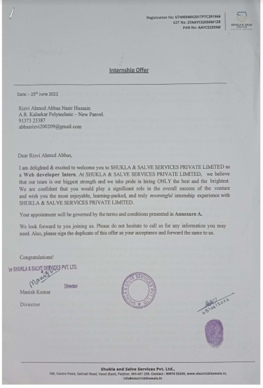
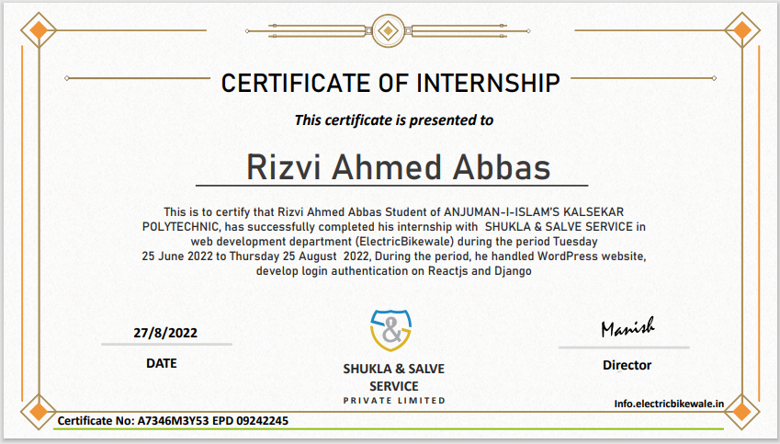
DOCUMENTS

Slide 4

Internship
I Had Completed Internship at Electric BikeWale On Web Development for 3 Months
It is a Electric Bike or other Products Seller R&D Company
I had Applied on InternShala for Internship at Electric BikeWale
I have been Interviewed with Company’s Director and Accepted as an Intern Web development.
Electric BikeWale

Slide 5
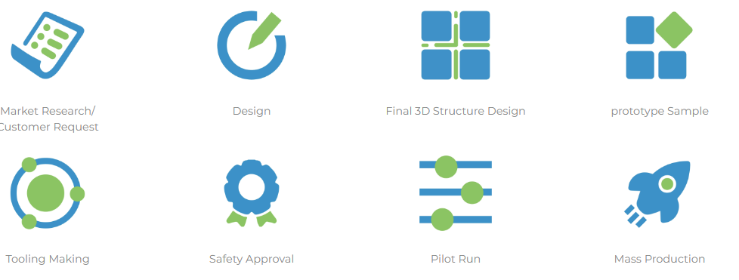
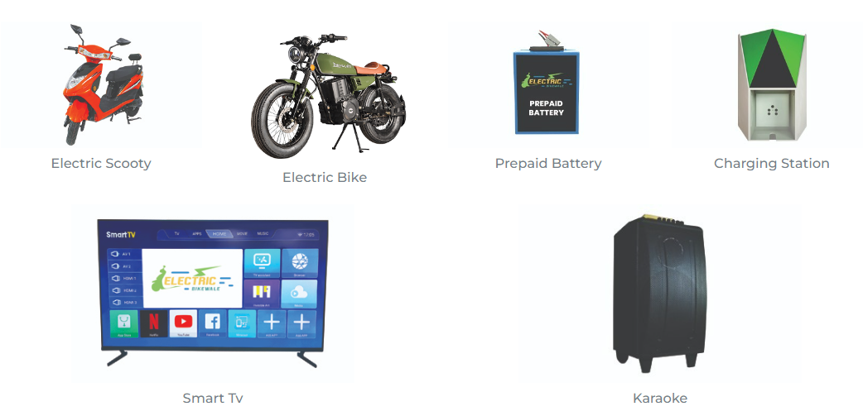
About Company
Company Service
Electric BikeWale is can e-commerce Website.
It has a strong Production R&D and manufacturing team, quality control team
EBW has developed into a modern comprehensive manufacturing enterprise integrating the R&D, manufacturing and sales of Automotive parts such as Electric Vehicle, Charging station, Prepaid EV battery and consumer products
Company’s Products

Slide 6
Language & Technology I learned and Implemented
List of Programming Languages I have Learn and Implemented:
Frontend
HTML & CSS
JavaScript
Wordpressed (php)
Framework
React.js (JavaScript)
Django (Python)
Backend
Python
Django API:
REST API
(REST Frameworks)
Other Technology
XAMPP Server
POSTMAN
Google API:
1) OAuth 2.0 to Access Google APIs

Slide 7
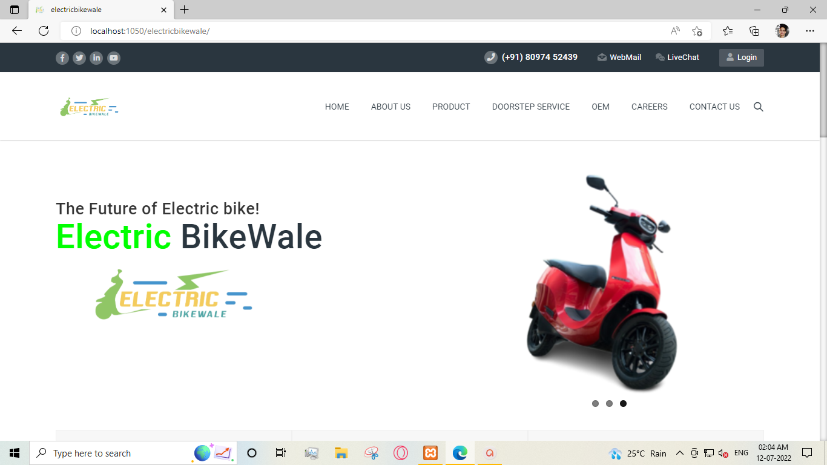
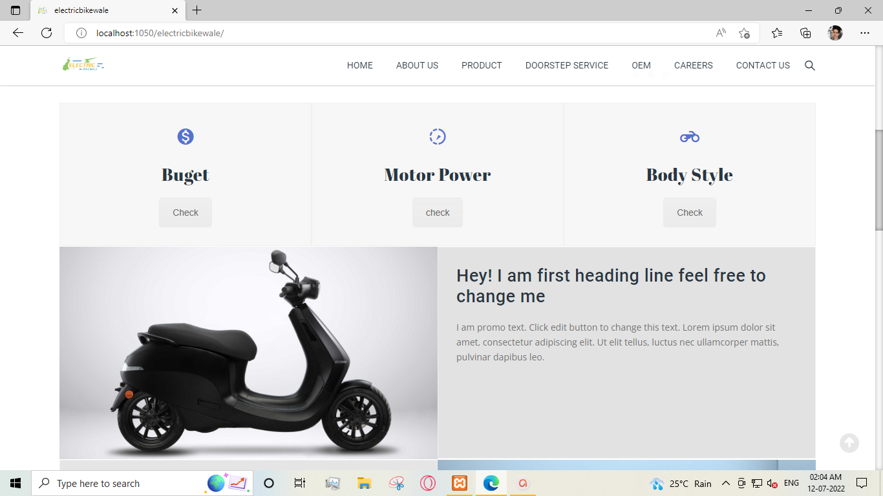
WordPressed Development
Implement whole Wordpressed project (website) A demo Project website on WordPress Development, our main website is built upon WordPress so Mr. Manish sir had assigned WordPress website project they gave me full freedom to create your own imagine website and implements many things first of all I had create a very good-looking Landing page and then different pages such as about, contact page and ODEM pages. I have also implemented mails functionality SMPTS.
What is WordPressed?
WordPress is a content management system (CMS) that allows you to host and build websites. WordPress contains plugin architecture and a template system, so you can customize any website to fit your business, blog, portfolio, or online store.
What Language and tools is used:
Wordpressed (php) GUI Website Builder: WPBakery Page Builder
XAMPP SERVER for Local Live Hosting

Slide 8
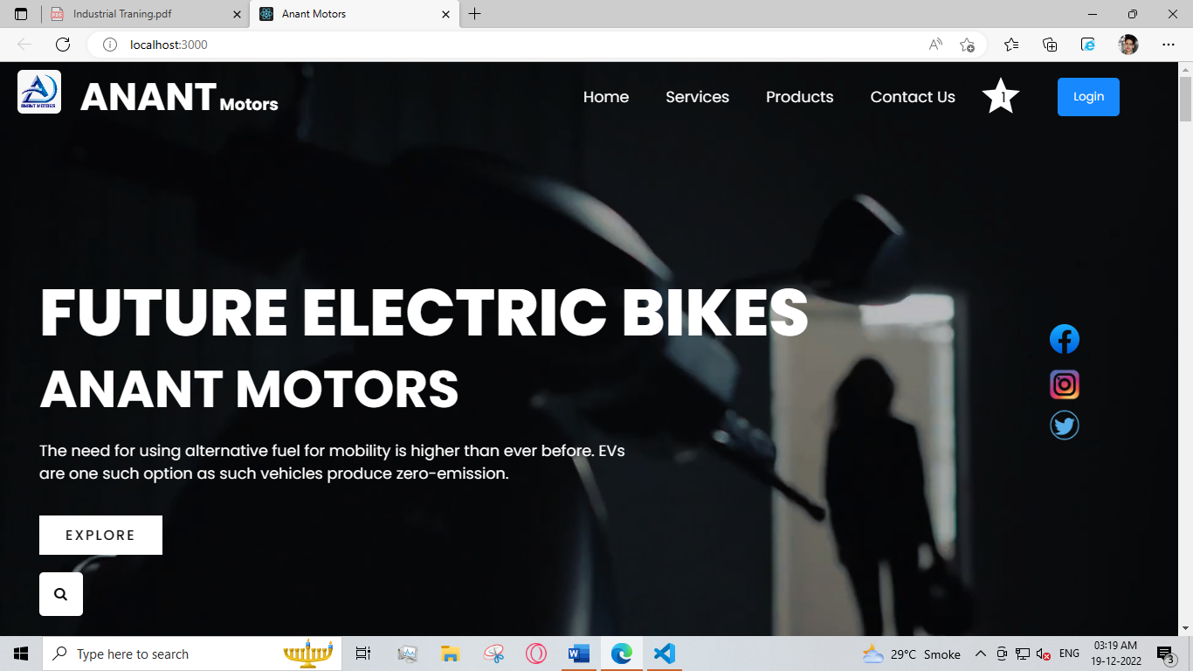
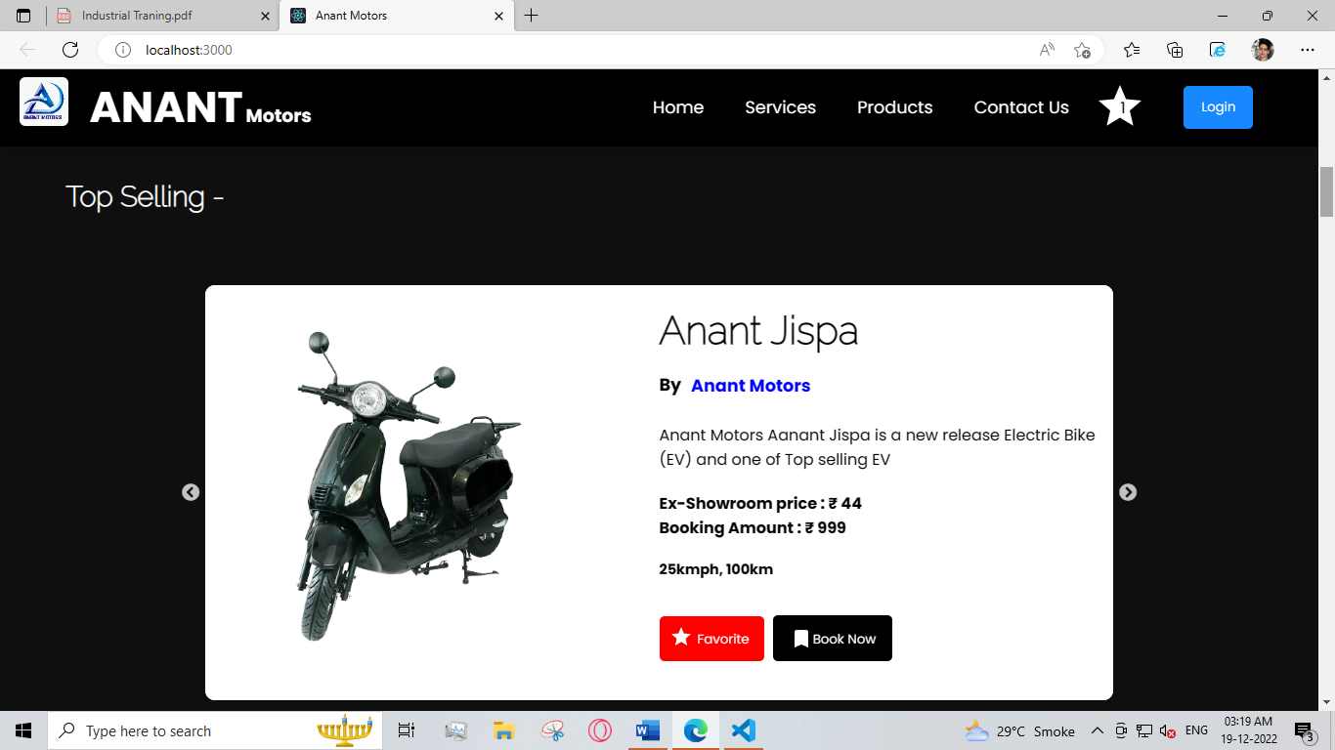
Anant Motors Project (React & Django)
Anant Motors, Anant Motors is a dynamic and interactive E-Commerce website which Sells Electric Bikes Online is build upon latest and leading technology React and Django, React as a Fronted and Django as a Backend.
The Fronted of this project is React.js it is a very reliable and efficiency language that is based on JavaScript’s and JavaScript is one of the most popular and most reliable language
the backend works like user authentication and user data saving like add to cart, it is dynamic and interactive website which means it different for every user, this project backend is built upon Django, Django is a python-based language. It has a wide variety of package for user Authentication and other important activities.
Language, Frameworks and Tools Used
HTML & CSS, JavaScript, Python, React.js, Django, POSTMAN

Slide 9
